Slide 1
Gas Station Customer Profiles 7/2019 vs 7/2021
Presented by Ashley Rabanales, Brad Ashworth, Zack Lee

Slide 2
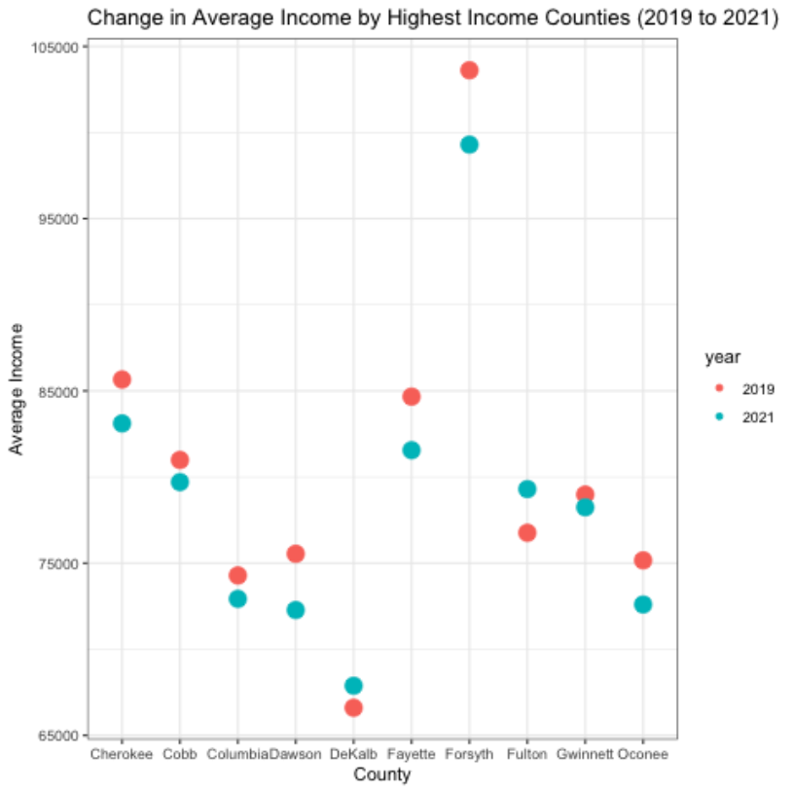
Median income for gas station customers had decreases in 8 of top 10 counties in GA between 7/19 and 7/21.

Slide 3
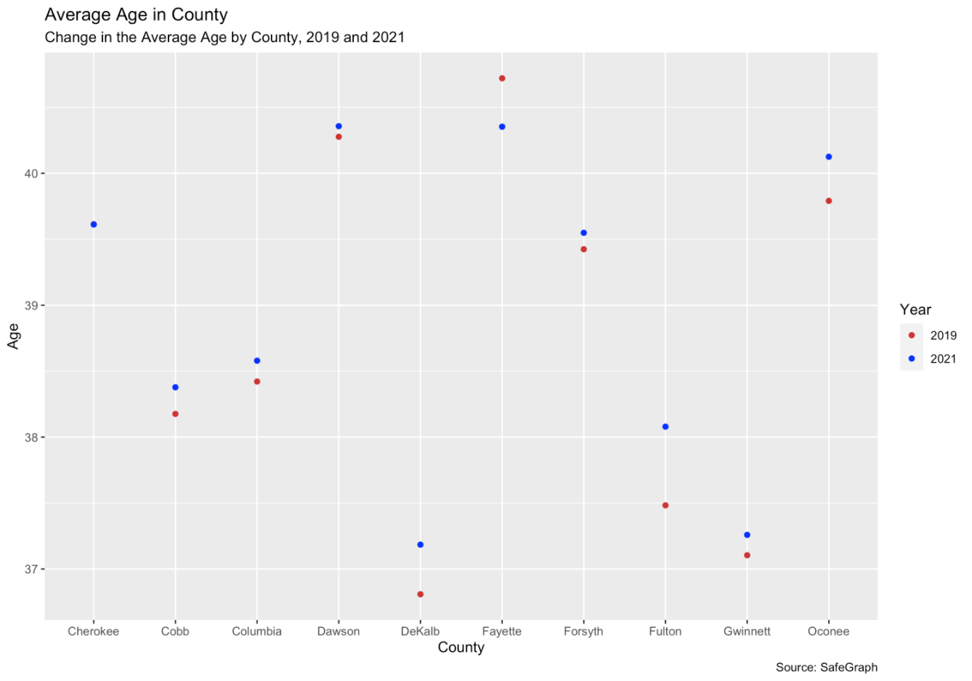
Median age had no abnormal shift between 7/19 and 7/21.

Slide 4
There are four counties with large shifts in the customer race mixes.

Slide 5
Follow Ups
Analysis By Brand
Additional research should be conducted by brands to determine if profile changes are across the industry, or specific to a brand.
Analysis By Census Blocks
Additional research to be done on census block level areas to see if rural, suburban, and downtowns have the same impact.
Analysis Of Other States
This analysis was started in GA but should be expanded to other states to determine if it is a localized phenomenon or throughout the USA.

